Slide 1
Machine Learning
“Field of study that gives computers the ability to learn without being explicitly programmed.”
- Arthur Samuel (1959)

Slide 2
Logistic Regression
(Binary Classification)

Slide 3
Logistic Regression
What is logistic regression?
Logistic regression is an example of supervised learning.
It is used to calculate or predict the probability of a binary (yes/no) event occurring.
An example of logistic regression could be applying machine learning to determine if a tumor is likely to be malignant or benign.
Since we have two possible outcomes to this question - yes, it’s malignant, or no, it’s benign - this is called binary classification.

Slide 4


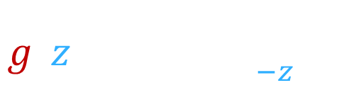


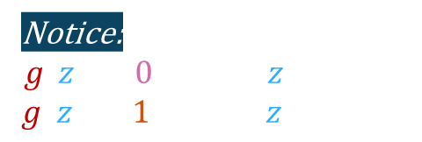




Sigmoid Function
$$g(z)$$
x
$$1$$
x
x
x
(yes) 1
x
Notice:
$$g\left(z\right)→0 when z→−∞$$
$g\left(z\right)→1 when z→∞$
0.7
malignant?
0.5
(no) 0
x
x
x
x
$$0$$
$$z$$
So why does sigmoid function have this shape?
tumor size $x$
(diameter in cm)
Sigmoid function
Logistic function
Want outputs between $0$ and $1$
outputs between $0$ and $1$
$$g\left(z\right)= \frac{1}{1+ e^{−z} }$$
$$0<g\left(z\right)<1$$

Slide 5

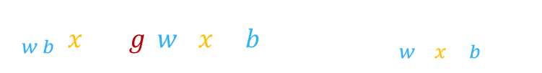




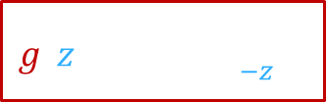





Sigmoid Function
$$g(z)$$
$$1$$
$$f_{w,b}(x)$$
$$z=w \text{∙} x+b$$
0.5
$$z$$
$$0$$
$$z$$
$$g\left(z\right)= \frac{1}{1+ e^{−z} }$$
Sigmoid function
Logistic function
outputs between $0$ and $1$
$$f_{w,b}\left(x\right)=g\left(w \text{∙ }x+b\right)=\frac{1}{1+ e^{−(w \text{∙ }x + b)} }$$
$$g\left(z\right)= \frac{1}{1+ e^{−z} }$$
$$0<g\left(z\right)<1$$
$$z$$
“Logistic Regression”

Slide 6


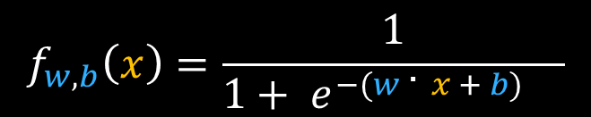


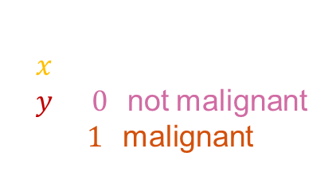
Interpretation of logistic regression output
$$f_{w,b}\left(x\right)=\frac{1}{1+ e^{−(w \text{∙ }x + b)} }$$
$$f_{w,b}\left(x\right)=P\left(y=1|x;w, b\right)$$
“probability” that class is $1$
Probability that $y$ is $1$, given input $x$, parameters $w,b$.
Example:
$x$ is “tumor size”
$y$ is $0$ (not malignant)
or $1$ (malignant)
$$P\left(y=0\right)+P\left(y=1\right)=1$$
$$f_{w,b}\left(x\right)=0.7$$
$70\%$ that $y$ is $1$

Slide 7
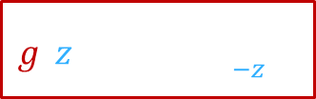



















Interpretation of logistic regression output
$$g(z)$$
$$f_{w,b}\left(x\right)=g\left(w \text{∙ }x+b\right)=\frac{1}{1+ e^{−(w \text{∙ }x + b)} }=P\left(y=1|x;w, b\right)$$
$$1$$
$$z$$
$$1$$
$$0.7$$
$$0.3$$
$$0 or 1 ?$$
0.5
threshold
$$0$$
$$0$$
$$z$$
When is $f_{w,b}\left(x\right)≥0.5 ?$
$$f_{w,b}(x)$$
$$g\left(z\right)≥0.5$$
$$z=w \text{∙} x+b$$
threshold
$$z≥0$$
$$z$$
Is $f_{w,b}\left(x\right)≥0.5 ?$
$$w \text{∙ }x+b≥0$$
$$w \text{∙ }x+b<0$$
Yes: $\hat{y}=1$
No: $\hat{y}=0$
$$\hat{y}=1$$
$$\hat{y}=0$$
$$g\left(z\right)= \frac{1}{1+ e^{−z} }$$

Slide 8

















Decision Boundary
$$x_{2}$$
x
x
$$\hat{y}=1$$
$$f_{w,b}\left(x\right)=g\left(z\right)=g\left(w_{1}x_{1}+w_{2}x_{2}+b\right)$$
$$3$$
x
x
x
$$1$$
$$1$$
$$−3$$
x
x
x
$$2$$
x
Decision Boundary
$$z=w \text{∙ }x+b=0$$
x
x
$$1$$
$$z=x_{1}+x_{2}−3=0$$
$$x_{1}$$
$$x_{1}+x_{2}=3$$
$$1$$
$$2$$
$$3$$
$$\hat{y}=0$$

Slide 9























Non-linear Decision Boundaries
$$x_{2}$$
Note: It’s possible you can get even more complex decision boundaries.
x
x
x
$$z=w_{1}x_{1}^{2}+w_{2}x_{2}^{2}+b$$
x
x
x
$$x_{2}$$
x
x
$$f_{w,b}\left(x\right)=g\left(z\right)=g\left(w_{1}x_{1}^{2}+w_{2}x_{2}^{2}+b\right)$$
x
x
$$1$$
x
x
$$1$$
$$1$$
$$−1$$
x
x
x
x
$$\hat{y}=1$$
x
x
$$z=x_{1}^{2}+x_{2}^{2}−1$$
$$x_{1}$$
$$x_{1}$$
$$−1$$
$$1$$
x
x
x
Decision Boundary:
$$z=0$$
x
x
$$x_{2}$$
x
$$−1$$
x
x
$$x_{1}^{2}+x_{2}^{2}=1$$
x
x
x
x
x
x
x
x
$$\hat{y}=1$$
$$x_{1}^{2}+x_{2}^{2}≥1$$
$$x_{1}$$
$$x_{1}^{2}+x_{2}^{2}<1$$
$$\hat{y}=1$$
$$\hat{y}=0$$

Slide 10

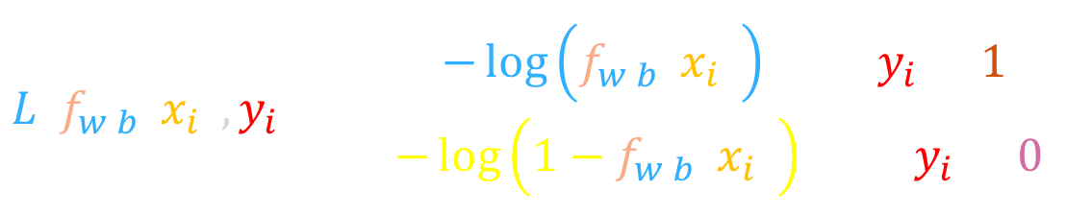

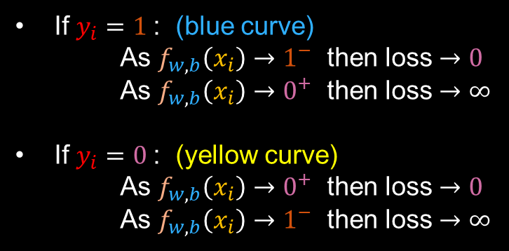




Logistic loss Function
$$L\left(f_{w,b}\left(x_{i}\right),y_{i}\right)=\left\{\begin{aligned}−\log\left(f_{w,b}\left(x_{i}\right)\right), y_{i}=1 \\ &−\log\left(1−f_{w,b}\left(x_{i}\right)\right), y_{i}=0 \end{aligned}\right.$$
If $y_{i}=1$: (blue curve)
As $f_{w,b}\left(x_{i}\right)→1^{−}$ then loss $→0$
As $f_{w,b}\left(x_{i}\right)→0^{+}$ then loss $→∞$
If $y_{i}=0$: (yellow curve)
As $f_{w,b}\left(x_{i}\right)→0^{+}$ then loss $→0$
As $f_{w,b}\left(x_{i}\right)→1^{−}$ then loss $→∞$
$$f$$
$$0$$
$$1$$
$$f$$
$$0$$
$$1$$

Slide 11
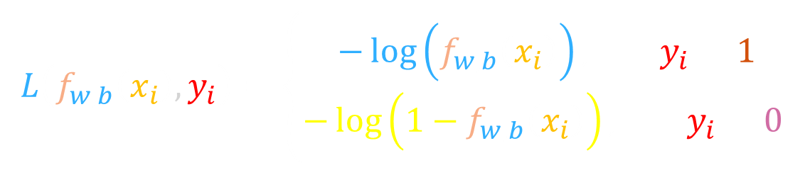
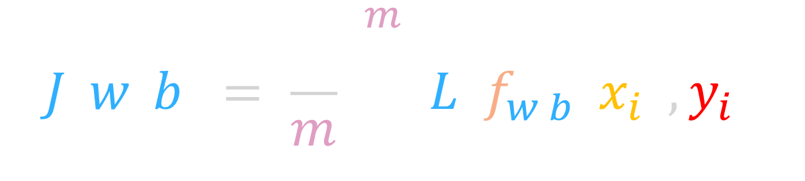

Cost Function
$$J\left(w, b\right)= \frac{1}{m}\sum_{i=1}^{m}{L\left(f_{w,b}\left(x_{i}\right),y_{i}\right)}$$
Convex
i.e., Gradient Descent can reach global minimum.
$$L\left(f_{w,b}\left(x_{i}\right),y_{i}\right)=\left\{\begin{aligned}−\log\left(f_{w,b}\left(x_{i}\right)\right), y_{i}=1 \\ &−\log\left(1−f_{w,b}\left(x_{i}\right)\right), y_{i}=0 \end{aligned}\right.$$
Find $w, b$that minimize cost function $J$…

Slide 12
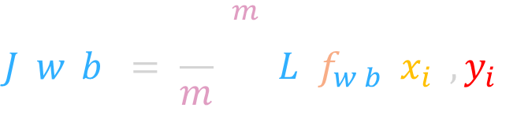
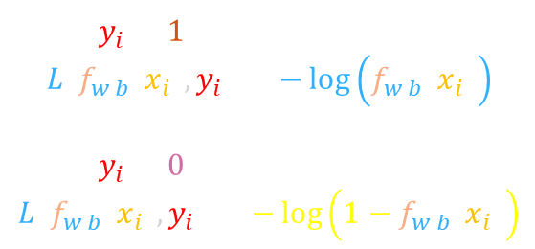
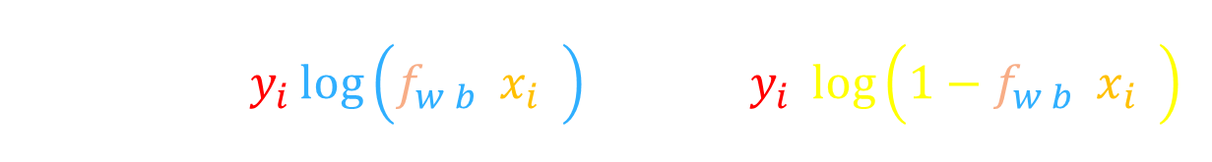
Simplified Cost Function
Simplified Loss Function:
$$L\left(f_{w,b}\left(x_{i}\right),y_{i}\right)=−y_{i}\log\left(f_{w,b}\left(x_{i}\right)\right)−(1−y_{i})log\left(1−f_{w,b}\left(x_{i}\right)\right)$$
If $y_{i}=1$:
$$L\left(f_{w,b}\left(x_{i}\right),y_{i}\right)=−\log\left(f_{w,b}\left(x_{i}\right)\right)$$
If $y_{i}=0$:
$$L\left(f_{w,b}\left(x_{i}\right),y_{i}\right)=−\log\left(1−f_{w,b}\left(x_{i}\right)\right)$$
Simplified Cost Function:
$$J\left(w, b\right)= \frac{1}{m}\sum_{i=1}^{m}{L\left(f_{w,b}\left(x_{i}\right),y_{i}\right)}$$
$$=−\frac{1}{m}\sum_{i=1}^{m}{\left[y_{i}\log\left(f_{w,b}\left(x_{i}\right)\right)+(1−y_{i})log\left(1−f_{w,b}\left(x_{i}\right)\right)\right]}$$

Slide 13

Gradient Descent (optimization)
Loss Function
$$L\left(f_{w,b}\left(x_{i}\right),y_{i}\right)=−y_{i}\log\left(f_{w,b}\left(x_{i}\right)\right)−(1−y_{i})log\left(1−f_{w,b}\left(x_{i}\right)\right)$$
$$J\left(w, b\right)= \frac{1}{m}\sum_{i=1}^{m}{L\left(f_{w,b}\left(x_{i}\right),y_{i}\right)}=−\frac{1}{m}\sum_{i=1}^{m}{\left[y_{i}\log\left(f_{w,b}\left(x_{i}\right)\right)+(1−y_{i})log\left(1−f_{w,b}\left(x_{i}\right)\right)\right]}$$
Cost Function
Same concepts:
Monitor gradient descent (learning curve)
Vectorized implementation
Feature scaling
$$repeat \{w≔w − \frac{α}{m}\sum_{i=0}^{m}{\left({\hat{y}}_{i}−y_{i}\right)}x_{i},$$
$$b≔b−\frac{α}{m}\sum_{i=0}^{m}{\left({\hat{y}}_{i}−y_{i}\right)}$$
$\} simultaneous updates$
Gradient Descent
…Looks like linear regression

Slide 14

Performance Metrics (Evaluation)
When determining how well your model is performing, the most common measure to use is accuracy.
$$Accuracy= \frac{\# correctly labeled examples}{total \# examples in the dataset}$$
However, accuracy is not always the best measure, especially for unbalanced datasets.

Slide 15
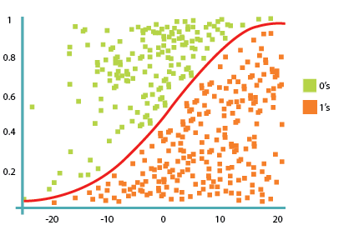
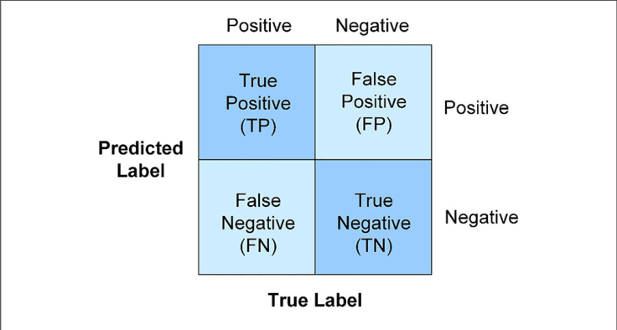
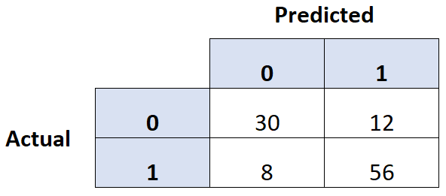
Performance Metrics (Evaluation)
Confusion Matrices
A confusion matrix is a matrix grid that compares actual classes to predicted classes (actual, predicted)

Slide 16
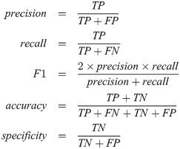
Performance Metrics (Evaluation)
There are more Performance Metrics such as precision and recall
They are all popular metrics. They could be computed directly from the confusion matrix, but there are built in functions in sklearn can be used.

Slide 17
Coding Time…

Slide 18
Thank You

